Slide 1
Analysing variation in atmospheric carbon dioxide
A graph interpretation activity
Using the film “Thin Ice – The Inside Story of Climate Science”
Shane Delaney
Onslow College

Slide 2
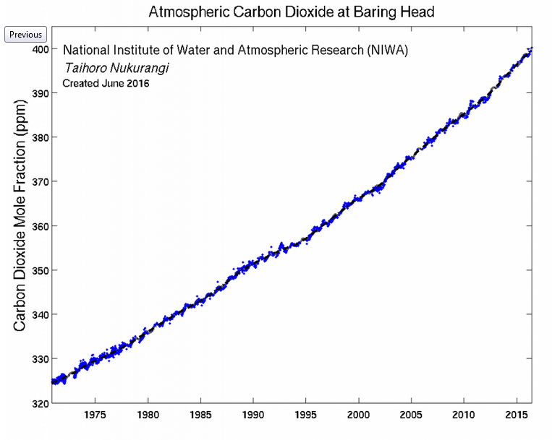
https://www.niwa.co.nz/atmosphere/our-data/trace-gas-plots/carbon-dioxide

Slide 3
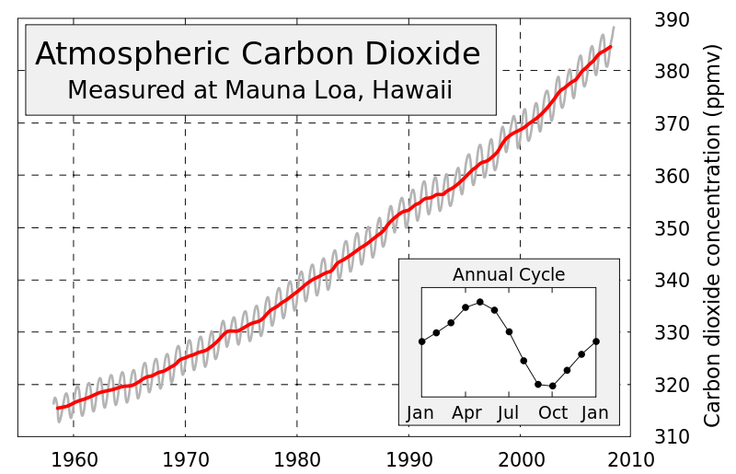
https://www.skepticalscience.com/warming-co2-rise.htm

Slide 4
Questions for fast finishers:
What processes do you know of that ‘use up’ CO₂?
What processes do you know of that release CO₂?
What percentage is 350ppm equal to?
Compare and contrast atmospheric CO₂ and air (describe the similarities and differences).

Slide 5
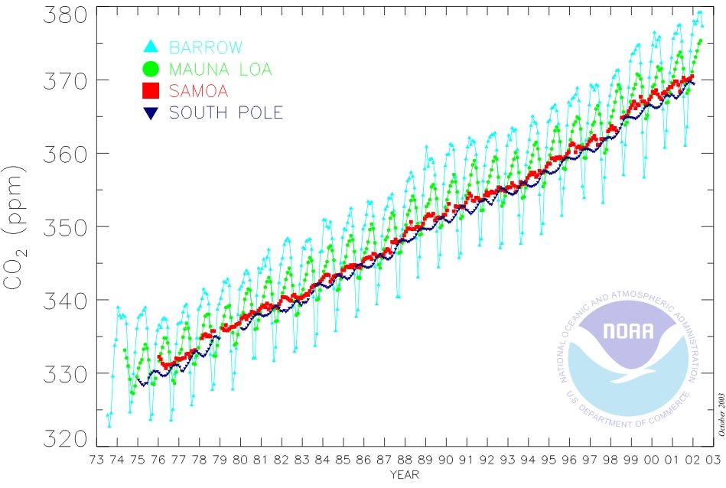
http://www.co2.ulg.ac.be/objects/mangroves_co2_air.htm

